Slide 1
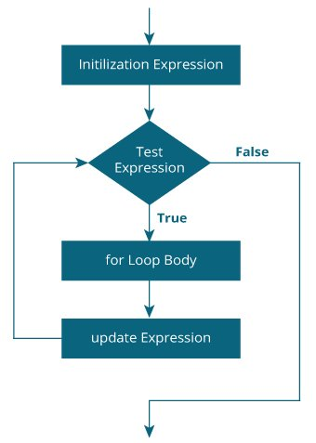
For Loop
The initialization statement is executed only once.
Then, the test expression is evaluated. If the test expression is evaluated to false, the for loop is terminated.
However, if the test expression is evaluated to true, statements inside the body of the for loop are executed, and the update expression is updated.
Again the test expression is evaluated.

Slide 2
Syntax
for(Expression 1(Initialization); Expression 2(condition); Expression 3(increment/decrement))
{
//code to be executed
}

Slide 3
Properties of Expression 1
The expression represents the initialization of the loop variable.
We can initialize more than one variable in Expression 1.
Expression 1 is optional.
In C, we can not declare the variables in Expression 1. However, It can be an exception in some compilers.

Slide 4
Properties of Expression 2
Expression 2 is a conditional expression. It checks for a specific condition to be satisfied. If it is not, the loop is terminated.
Expression 2 can have more than one condition. However, the loop will iterate until the last condition becomes false. Other conditions will be treated as statements.
Expression 2 is optional.
Expression 2 can perform the task of expression 1 and expression 3. That is, we can initialize the variable as well as update the loop variable in expression 2 itself.
We can pass zero or non-zero value in expression 2. However, in C, any non-zero value is true, and zero is false by default.

Slide 5
Properties of Expression 3
Expression 3 is used to update the loop variable.
We can update more than one variable at the same time.
Expression 3 is optional.

Slide 6
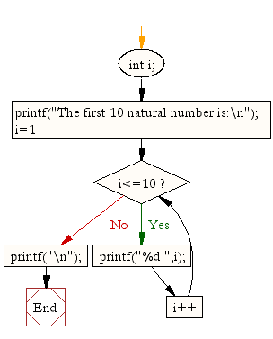
1)Write a program in C to display the first 10 natural numbers
#include <stdio.h>
int main()
{
int i;
printf("The first 10 natural numbers are:\n");
for (i=1;i<=10;i++)
{
printf("%d ",i);
}
printf("\n");
}
OUTPUT
The first 10 natural numbers are:
1 2 3 4 5 6 7 8 9 10

Slide 7
2)Write a program in C to display n terms of natural numbers and their sum.
#include <stdio.h>
int main()
{
int i,n,sum=0;
printf("Input Value of terms : ");
scanf("%d",&n);
printf("\nThe first %d natural numbers are:\n",n);
for(i=1;i<=n;i++)
{
printf("%d ",i);
sum+=i;
}
printf("\nThe Sum of natural numbers upto %d terms : %d \n",n,sum);
}
OUTPUT
Input Value of terms : 10
The first 7 natural number is :
1 2 3 4 5 6 7 8 9 10
The Sum of Natural Number upto 7 terms : 55

Slide 8
3)Write a C program of a for loop that prints the even numbers from 2 to 20
#include <stdio.h>
int main() {
int i;
for (i = 2; i <= 20; i += 2) {
printf("%d ", i);
}
return 0;
}
Output
2 4 6 8 10 12 14 16 18 20

Slide 9
Nested Loop
In C programming, nested loops are loops that are defined inside other loops. They allow for the execution of one or more inner loops for each iteration of the outer loop. Nested loops are useful when we need to perform a repetitive task for every combination of values that we get from the outer loop and the inner loop.
For example, if we have a two-dimensional array with rows and columns, we can use nested loops to iterate over each element in the array. The outer loop will iterate over the rows, while the inner loop will iterate over the columns.

Slide 10
Q)Use for loop in nested loop to print multiplication table.
#include <stdio.h>
int main() {
int i, j;
for (i = 1; i <= 10; i++) { // outer loop to iterate over numbers 1 through 10
for (j = 1; j <= 10; j++) { // inner loop to iterate over numbers 1 through 10
printf("%d\t", i*j); // print the product of i and j, followed by a tab character
}
printf("\n"); // print a newline character after each row is printed
}
return 0;
}
OUTPUT
1 2 3 4 5 6 7 8 9 10
2 4 6 8 10 12 14 16 18 20
3 6 9 12 15 18 21 24 27 30
4 8 12 16 20 24 28 32 36 40
5 10 15 20 25 30 35 40 45 50
6 12 18 24 30 36 42 48 54 60
7 14 21 28 35 42 49 56 63 70
8 16 24 32 40 48 56 64 72 80
9 18 27 36 45 54 63 72 81 90
10 20 30 40 50 60 70 80 90 100

Slide 11
Common Mistakes and how to avoid it
Not initializing the loop variable: The loop variable needs to be initialized before the loop starts. If it is not initialized, it may have a random value that could cause unexpected behavior in the loop.
for(int i; i < (something); i++)
{
// some code here
}
In the above code, the variable i is not initialized with any value. This may lead to an unpredictable behavior.
To avoid this mistake, always initialize the loop variable before the loop starts. [ int i=0]

Slide 12
Common Mistakes and how to avoid it
2. Not using the correct loop condition: The loop condition should be checked at the beginning of each iteration. If it is not checked correctly, the loop may execute too many or too few times.
for(int i = 0; i <= 10; i++)
{
// some code here
}
In the above code, the loop will execute 11 times, which may not be the intended behavior.
To avoid this mistake, use the correct loop condition.
[i<10]

Slide 13
Common Mistakes and how to avoid it
3.Not updating the loop variable: The loop variable should be updated at the end of each iteration. If it is not updated, the loop may execute indefinitely.
for(int i = 0; i < 10;)
{
// some code here
}
In the above code, the loop variable i is not being updated, which may cause the loop to execute indefinitely.
To avoid this mistake, always update the loop variable at the end of each iteration.
[int i = 0; i < 10; i++]

Slide 14
Common Mistakes and how to avoid it
4.Using an excessive number of loop iterations:Sometimes beginners use too many loop iterations, which can result in unnecessary computations and slow down the program. For example, consider the following loop that computes the sum of the first 1000 numbers:
int sum = 0;
for (int i = 1; i <= 1000; i++) {
sum += i;
}
This loop works correctly and computes the correct sum, but it may be slow for large values of n. To avoid this, we could modify the loop to use a larger increment value, such as 10:
[int i = 1; i <= 1000; i += 10]

